Slide 1
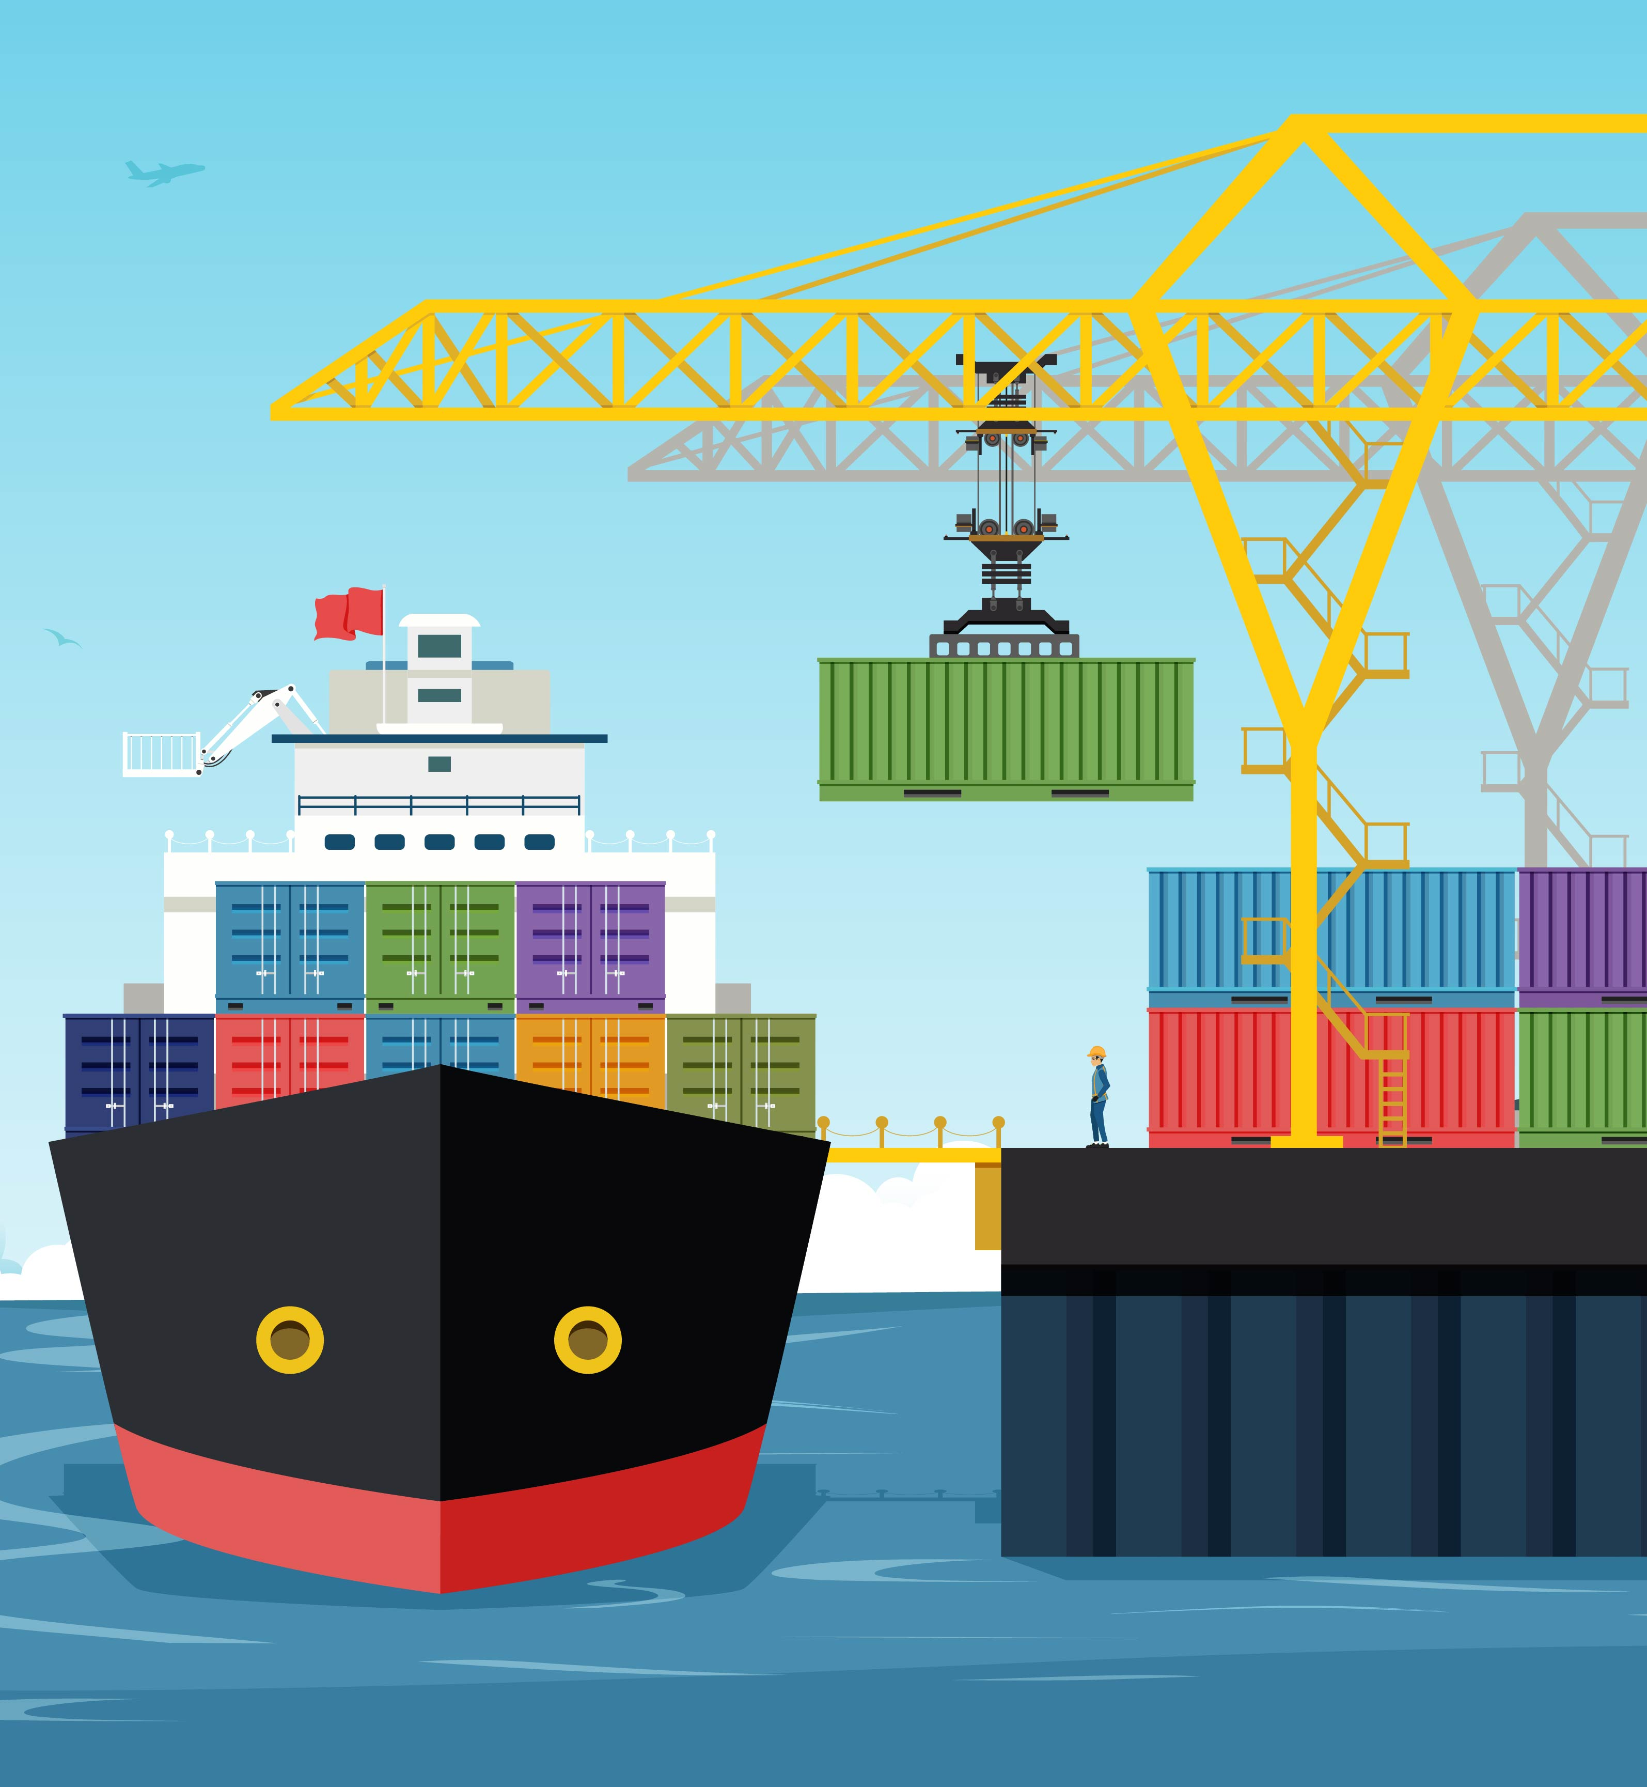
Welcome! Please complete the Setup section if you have not already.
Wi-Fi network:
InterSystems
gs23hollywood

Slide 2
Containers Workshop
Global Summit 2023
June 4, 2023
Notes:
This is the primary slide used for titles/opening. There are 5 alternative layouts that can be used when needed. You can access the alternative layout options by:
- Right clicking on the slide thumbnail on the left-hand side > Layout > choose from Title Slide, Title Slide (dark), Title Slide (picture), Title Slide (picture dark), and Title Slide (option B). The pre-set type sizes and type size recommendations for the Title slides’ title text placeholders are guidance only, if the title is much longer or shorter than the font size allows, it can be either increased or decreased.

Slide 3
Introduction

Slide 4
Introduction
Workshop Structure
Why Use Containers?
What Are Containers?
Basic Container Operations
Persisting Data in a Container
InterSystems IRIS in Containers
Understanding InterSystems IRIS in Containers
Using Durable %SYS
A Closer Look at Containers
Inspecting Container Logs
Using Build Processes
Using Docker Compose for Multiple Containers
Putting It All Together
Build a Containerized Application on InterSystems IRIS
Agenda

Slide 5
Workshop Presenters
Derek Robinson
Senior Technical Online Course Developer
Erik Hemdal
Principal Quality Development Engineer
Kerry Kirkham
Sales Engineer
Bob Kuszewski
Product Manager — Developer Experience
And several more InterSystems experts are available to assist
you throughout the workshop!

Slide 6
Workshop Structure
4 hour duration
2pm to 6pm
Helpers can assist with machine setup
Loaner machines available on a limited basis if needed
Presentations at breakpoints in the exercise
Feel free to proceed if you are ahead, or grab some coffee and wait!
Designed to be taken home
By using your own machine, you’ll walk out with a running version of your containerized application!

Slide 7

2:00 – 2:30: Setup & Introduction (Derek)
2:30 – 3:00: Work on Exercises 1-3
3:00 – 3:15: Presentation (Erik)
3:15 – 3:30: Work on Exercise 4
3:30 – 3:45: Coffee break
3:45 – 4:00: Presentation (Kerry)
4:00 – 4:30: Work on Exercises 5-6
4:30 – 4:45: Presentation (Bob)
4:45 – 6:00: Work on Exercise 7 & Bonus
Schedule

Slide 8
What are Containers?

Slide 9
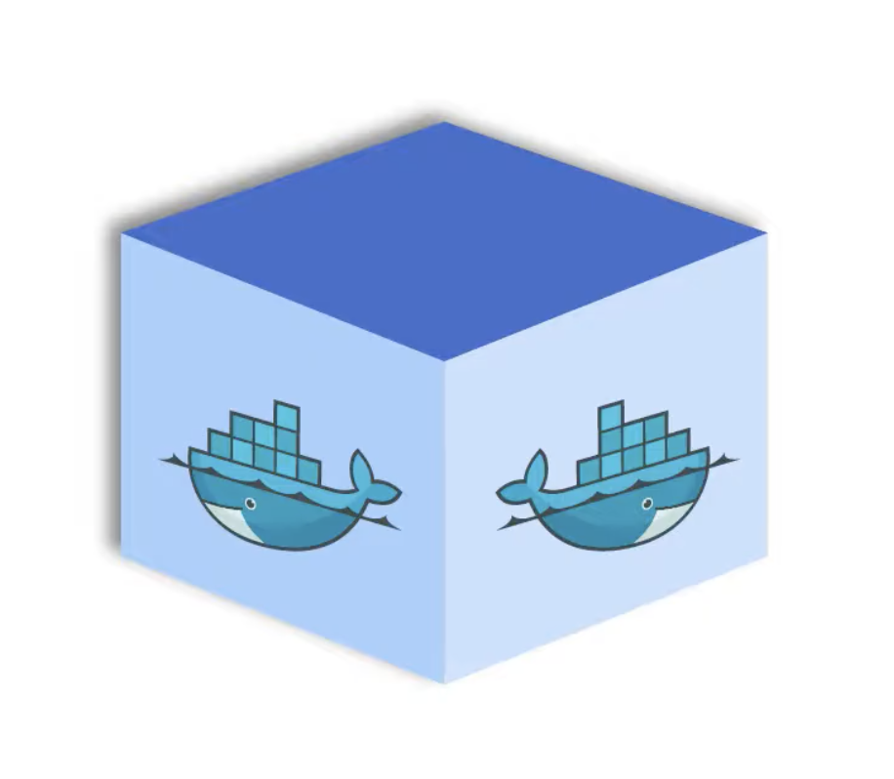
What is a Container?
Containers are platform-independent units of software
Code and all dependencies are packaged for application to run quickly and reliably
Runnable on any host system that has a container runtime engine
Portable and efficient runtime solution

Slide 10
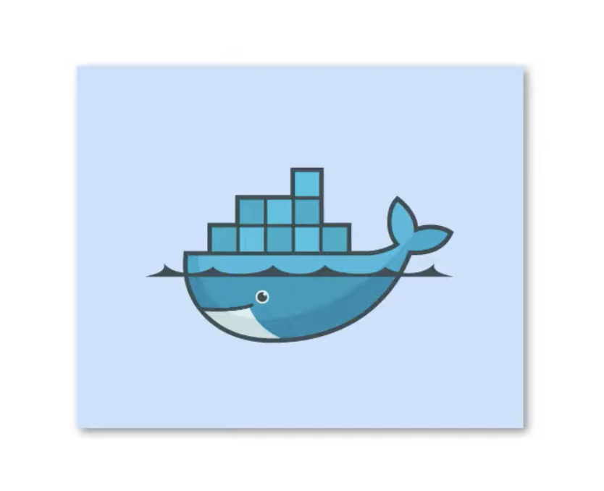
Containers and Images
Container Images are standardized, portable, runnable software bundles.
Think of an installable software package.
Containers are running instances of images, executed in isolation and resource-controlled.
Think of a running instance of that software package.

Slide 11

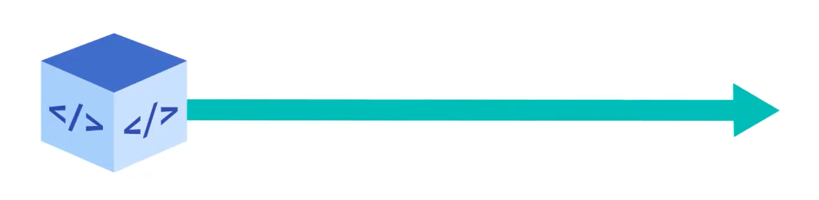
The Efficiency of Containers
Containers allow you to move your application code through various environments—such as from DEV to TEST to PROD—without the friction of build discrepancies and software dependencies.

Slide 12
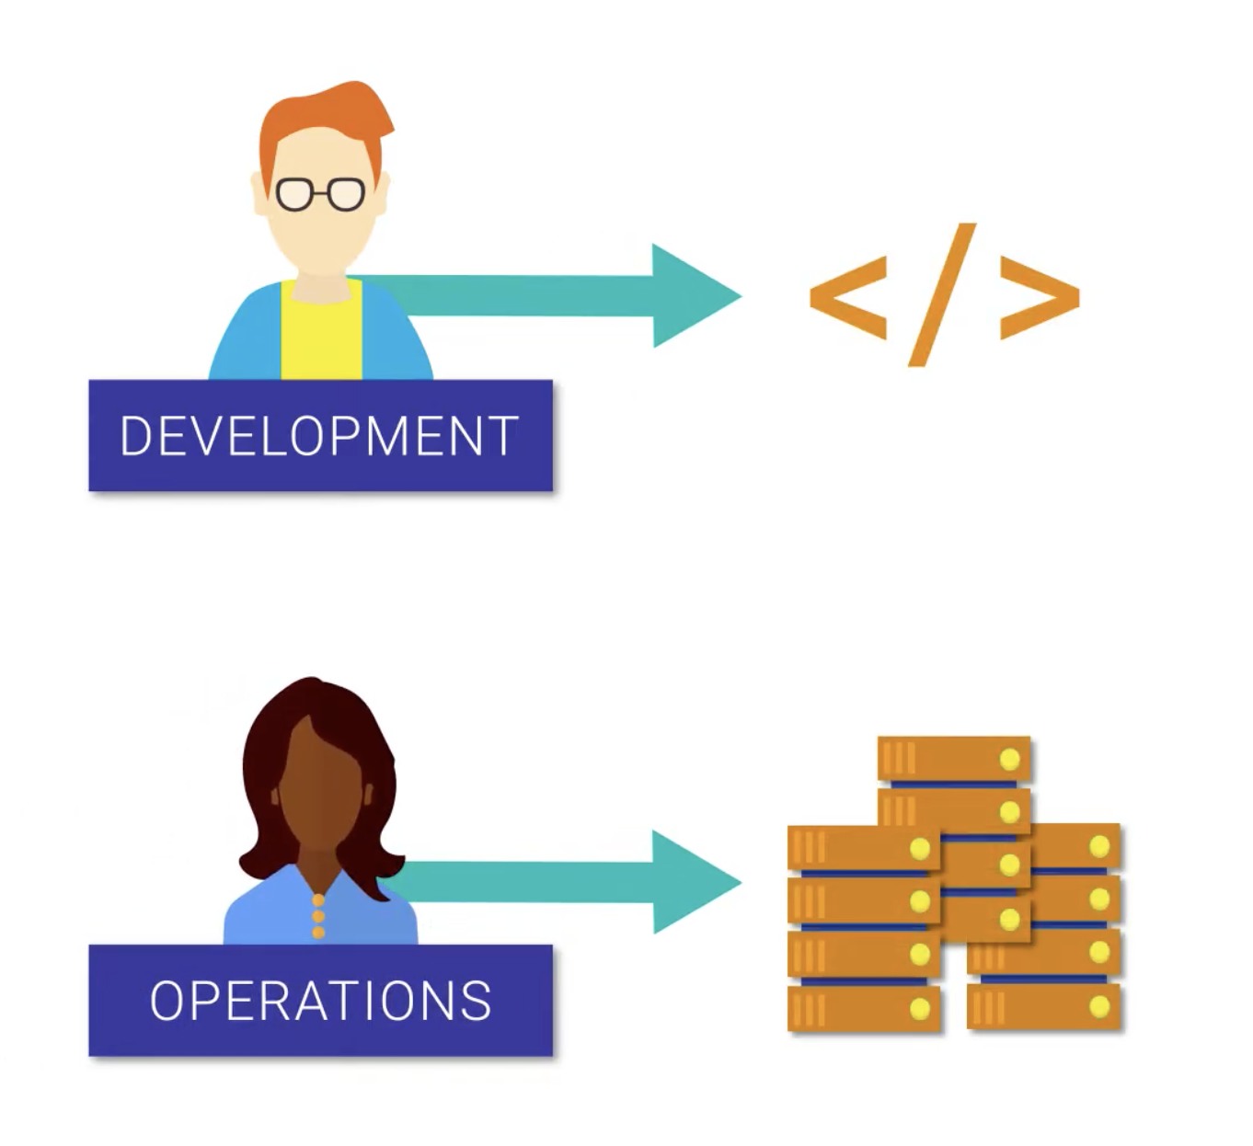
The Efficiency of Containers
This allows developers to focus on writing code, and operations engineers to focus on efficient deployment and delivery.

Slide 13
Building and Running Containers
You can build a container image using a Dockerfile, which defines exactly what the image includes, and a docker build command.
You can run a container using a docker run command, including various criteria for how that container should be created.

Slide 14
Exercise
Try Exercises 1-3
Ask for help if you need it
Next presentation:
3:00 PM

Slide 15
InterSystems IRIS in Containers

Slide 16
Why are we here?
To learn about differences between containerized deployments and traditional deployments on virtual machines
To learn key InterSystems IRIS features for control and persistence (iris-main, Durable %SYS)
To see some practical details about running InterSystems IRIS in a container

Slide 17
Containers vs. Virtual Machines
A Container is an Application
“Just” processes running code
Files are ephemeral
Isolated from the rest of the system (storage, networking, privileges)
A VM is well… a Machine
A fully virtualized environment
OS, Memory, File System, etc.
Different Use Cases
VMs allow for density of Machines on hardware
Containers allow for density of Applications on hardware
Application
Application
Virtual Machine OS
Virtual Machine OS
Hypervisor
Hardware
C. App
C. App
C. App
C. App
C. App
Operating System
Hardware

Slide 18
Containers are ephemeral. Databases aren’t.
Containers are “jails” for software that isolated from the rest of the computer
The filesystem they use is isolated
Network access is blocked outside the container
When the container is deleted, its filesystem goes away too
By default, this means they are stateless
The test.txt file vanished in the BusyBox exercise
The file was written into isolated storage that was inaccessible when you started the new container
That won’t work for InterSystems IRIS (or any database):
We need to arrange an orderly startup and shutdown (iris start… and iris stop…)
We need to manage network access
We need persistent data
Here’s how we do it

Slide 19
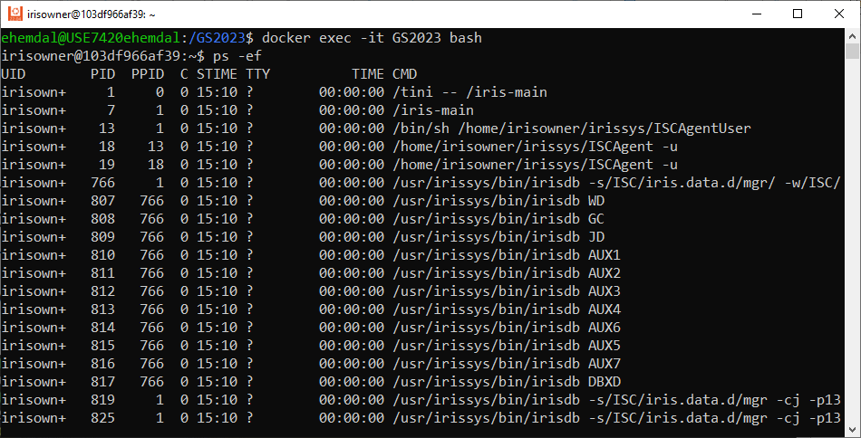
Orderly Start/Stop: the iris-main program
Starting the container starts iris-main, which remains running even if you shutdown IRIS via ‘iris stop’.
If the container is signaled to exit, iris-main will perform a clean shutdown for you.
There are many options that we won’t explore now.

Slide 20
Persisting data: Durable %SYS
To persist data, IRIS containers recognize an environment variable $ISC_DATA_DIRECTORY that you set at runtime – in your Docker run command
That directory must point to a directory outside of the container, on the host machine.
On first startup, IRIS will move the contents of the manager’s directory into $ISC_DATA_DIRECTORY, so IRISSYS, logs, journals, CPF, and necessary data will be persistent.
$ISC_DATA_DIRECTORY must be empty at first startup
If a later version of IRIS is started in a new container, it will be upgraded in-place using $ISC_DATA_DIRECTORY

Slide 21
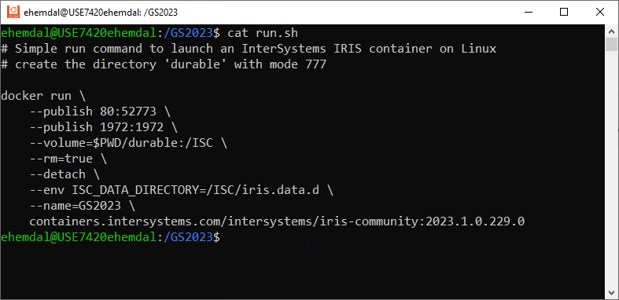
Details of run.sh: putting it all together
Let’s put everything together and look at a specific, simple run command

Slide 22
The run command: publishing network ports
docker run \
--publish 80:52773 \
--publish 1972:1972 \
--volume=$PWD/durable:/ISC \
--rm=true \
--detach \
--env ISC_DATA_DIRECTORY=/ISC/iris.data.d \
--name=GS2023 \
containers.intersystems.com/intersystems/iris-community:2023.1.0.229.0
These options open (“publish”) network ports so connections can be made from outside the container.
--publish host-port:container-port
This exposes the container’s private Web server outside on port 80, even though it is port 52773 inside the container.
The SuperServer is available on port 1972 both inside the container and outside on the host.
Change these ports if they conflict with some other application on your computer.

Slide 23
The run command: accessing persistent storage
docker run \
--publish 80:52773 \
--publish 1972:1972 \
--volume=$PWD/durable:/ISC \
--rm=true \
--detach \
--env ISC_DATA_DIRECTORY=/ISC/iris.data.d \
--name=GS2023 \
containers.intersystems.com/intersystems/iris-community:2023.1.0.229.0
The --volume option sets up a bind mount which lets the container use a (persistent) directory on the host.
The host directory is named "durable" under the current working directory. Inside the container, it will be accessed at /ISC.
The host directory needs to be writable by the container’s user – irisowner – so that IRIS can create the Durable %SYS directory here.
For our exercise, you can make it world-writable.
You can define more bind mounts for other directories if you need them.

Slide 24
The run command: set the Durable %SYS directory
docker run \
--publish 80:52773 \
--publish 1972:1972 \
--volume=$PWD/durable:/ISC \
--rm=true \
--detach \
--env ISC_DATA_DIRECTORY=/ISC/iris.data.d \
--name=GS2023 \
containers.intersystems.com/intersystems/iris-community:2023.1.0.229.0
Here is how we set the ISC_DATA_DIRECTORY environment variable.
The Durable %SYS directory will be /ISC/iris.data.d inside the container.
It will be $PWD/durable/iris.data.d on the host, based on where you start.
Notice that the Durable %SYS directory
$PWD/durable/iris.data.d
is not the same as the bind mount directory
$PWD/durable
so that the Durable %SYS directory will be empty at startup.

Slide 25
The run command: more options
docker run \
--publish 80:52773 \
--publish 1972:1972 \
--volume=$PWD/durable:/ISC \
--rm=true \
--detach \
--env ISC_DATA_DIRECTORY=/ISC/iris.data.d \
--name=GS2023 \
containers.intersystems.com/intersystems/iris-community:2023.1.0.229.0
--rm tells Docker to remove the container when it exits, so stopped containers don’t accumulate.
This is OK because your data is persisted in the Durable %SYS directory and in any other bind mounts you use.
--detach tells Docker to run the container in the background. If you leave this out, you’ll see the messages.log file scrolling on your terminal.
--name assigns a name to the container, so you don’t have to remember the long container ID.

Slide 26
The run command: the image and where to get it
docker run \
--publish 80:52773 \
--publish 1972:1972 \
--volume=/home/ehemdal/GS2023/durable:/ISC \
--rm=true \
--detach \
--env ISC_DATA_DIRECTORY=/ISC/iris.data.d \
--name=GS2023 \
containers.intersystems.com/intersystems/iris-community:2023.1.0.229.0
Finally, this specifies the container image to run
containers.intersystems.com is the container registry to pull from.
/intersystems/iris-community is the image to use.
2023.1.0.229.0 is the tag, or version we want.

Slide 27
Exercise
Try Exercise 4 - Pull and Run InterSystems IRIS Containers
Ask for help if you need it
When you finish, take a coffee break.
Next presentation:
3:45 PM

Slide 28
A Closer Look at Containers

Slide 29
Run a command in a container with docker exec
Overview
The docker exec command is used to run a command in a container
-it for Interactive Terminal programs
-u <username> to specify the user
-e <name>=<value> sets environment var
-d to run in the background
Examples
Run a non-interactive command:
$ docker exec <container ID> ls
Interactive Terminals
$ docker exec -it <container ID> sh
Interactive IRIS Session
$ docker exec -it <container ID> iris session iris

Slide 30
Container Logs
The docker logs command shows information logged by a running container.
STDIN is the command’s input stream, which may include input from the keyboard or input from another command.
STDOUT is usually a command’s normal output
STDERR is typically used to output error messages.
By default, docker logs shows the command’s STDOUT and STDERR
If your image runs a non-interactive process such as a web server or a database, that application may send its output to log files instead of STDOUT and STDERR

Slide 31
Logs Command Options
Use the container’s ID to inspect the logs it generated:
$ docker container logs [OPTIONS] <container ID>
Command [Options] | Description
--details | Display additional details provided to logs.
--follow, -f | Follow log output.
--since | Display logs since a specified timestamp (e.g. 2022-05-06T14:48:33Z) or relative (e.g. 20m).
--tail, -n | Specify the number of lines to show from the end of the logs.
--timestamps, -t | Show timestamp.
--until | Display logs before a specified timestamp.

Slide 32
Container Logs Location
Docker, by default, writes the standard output and standard error of all your containers in files using the JSON format.
The default logging driver for Docker is the JSON-file driver that stores logs on the host in the following directory:
/var/lib/docker
/containers/<container_id>/<container_id>-json.log
Docker Root Dir:

Slide 33
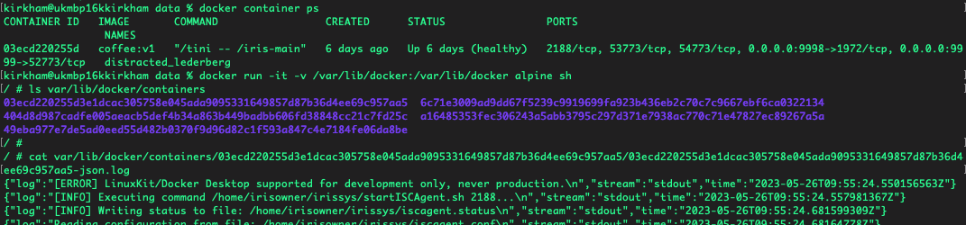
Container Logs Location
Docker, by default, writes the standard output and standard error of all your containers in files using the JSON format.
The default logging driver for Docker is the JSON-file driver that stores logs on the host in the following directory:
/var/lib/docker/containers/<container_id>/<container_id>-json.log

Slide 34
Using Build Process

Slide 35



Container Image Build Process
To build the container image, we’ll use a Dockerfile. A Dockerfile is simply a text-based file with no file extension that contains a script of instructions. Docker uses this script to build a container image.
Images are built out of read-only layers.
Dockerfiles specify image layer contents.
Key Dockerfile commands: FROM, RUN, COPY and ENTRYPOINT
BUILD
RUN
Docker File
Docker Image
Docker Container

Slide 36
Build Cache
Read Dockerfile Instruction
Docker will cache the results of the first build of a Dockerfile, allowing subsequent builds to be much faster
Cached build steps will be used until a change in the Dockerfile is found by the builder.
After completion, the resulting image layer is labelled with a hash of the content of all current image layers
The docker image history command allows us to inspect the build cache history of an image
$ docker image history myimage:latest
Using the build cache effectively is crucial for images that involve lengthy compile or download steps; in general, moving commands that change frequently as late as possible in the Dockerfile will minimize build times.
Is layer available in cache?
yes
no
Reuse
Build
Save image layer

Slide 37
Dockerfile Commands
FROM: base image to start from
RUN: run a command in the environment defined so far
CMD and ENTRYPOINT: define default behavior
COPY and ADD: copy files into container
For the exercise we will use the following:
# Deriving our container from a prebuilt one FROM node:16-slim COPY server.js . EXPOSE 8080 # Run the following default command when the container is run CMD node server.js

Slide 38
Dockerfile Commands
FROM: base image to start from
RUN: run a command in the environment defined so far
CMD and ENTRYPOINT: define default behavior
COPY and ADD: copy files into container
For the exercise we will use the following:
# Deriving our container from a prebuilt one FROM node:16-slim COPY server.js . EXPOSE 8080 # Run the following default command when the container is run CMD node server.js
Image that contains the minimal packages needed to run node

Slide 39
Dockerfile Commands
FROM: base image to start from
RUN: run a command in the environment defined so far
CMD and ENTRYPOINT: define default behavior
COPY and ADD: copy files into container
For the exercise we will use the following:
# Deriving our container from a prebuilt one FROM node:16-slim COPY server.js . EXPOSE 8080 # Run the following default command when the container is run CMD node server.js
Simple Node.js web server that handles HTTP requests

Slide 40
Dockerfile Commands
FROM: base image to start from
RUN: run a command in the environment defined so far
CMD and ENTRYPOINT: define default behavior
COPY and ADD: copy files into container
For the exercise we will use the following:
# Deriving our container from a prebuilt one FROM node:16-slim COPY server.js . EXPOSE 8080 # Run the following default command when the container is run CMD node server.js
Inform Docker that the container listens on port 8080 at runtime

Slide 41
Dockerfile Commands
FROM: base image to start from
RUN: run a command in the environment defined so far
CMD and ENTRYPOINT: define default behavior
COPY and ADD: copy files into container
For the exercise we will use the following:
# Deriving our container from a prebuilt one FROM node:16-slim COPY server.js . EXPOSE 8080 # Run the following default command when the container is run CMD node server.js
Set the command to be executed when running the image

Slide 42
Using Docker Compose for Multiple Containers

Slide 43
Docker Compose
Compose is a tool for defining and running multi-container Docker applications. With Compose, you use a YAML file to configure your application’s services. Then, with a single command, you create and start all the services from your configuration.
Compose works in all environments: production, staging, development, testing, as well as CI workflows. It also has commands for managing the whole lifecycle of your application:
Start, stop, and rebuild services
View the status of running services
Stream the log output of running services
Run a one-off command on a service

Slide 44
YAML – Yet Another Markup Language
Whitespace matters!
Tabs are not allowed as indentation for YAML. Use two spaces instead.
Indentation of whitespace is used to denote structure.
List members are denoted by a leading hyphen (-).
YAML is case sensitive
The files should have .yaml as the extension
version: ‘3.2'
services:
iris:
image: intersystems/iris:2023.1.0.299.0
restart: on-failure
cpu_percent: 25
ports:
- "9091:1972" # superserver default port
- "9092:52773” # webserver port
volumes:
- common_shared:/common_shared
- type: bind
source: ./advanced_analytics/shared/
target: /shared
environment:
- IRIS_MASTER_HOST=datalake
- IRIS_MASTER_PORT=51773
- IRIS_MASTER_NAMESPACE=APP
networks:
- datalake-tier
2 spaces
list

Slide 45
Docker Compose Example
version: '3.7'
services:
# iris container
iris:
image: containers.intersystems.com/intersystems/iris-community:2023.1.0.229.0
ports:
- "8881:1972"
volumes:
- type: bind
source: ./durable/compose
target: /iris-shared
. . .
# web gateway container
webgateway:
image: containers.intersystems.com/intersystems/webgateway:2023.1.0.229.0
ports:
- "8882:80"
. . .
A Service is an abstract definition of a computing resource within an application

Slide 46
Docker Compose Example
version: '3.7'
services:
# iris container
iris:
image: containers.intersystems.com/intersystems/iris-community:2023.1.0.229.0
ports:
- "8881:1972"
volumes:
- type: bind
source: ./durable/compose
target: /iris-shared
. . .
# web gateway container
webgateway:
image: containers.intersystems.com/intersystems/webgateway:2023.1.0.229.0
ports:
- "8882:80"
. . .
The service definition contains the configuration that is applied to each container started for that service

Slide 47
Docker Compose Example
version: '3.7'
services:
# iris container
iris:
image: containers.intersystems.com/intersystems/iris-community:2023.1.0.229.0
ports:
- "8881:1972"
volumes:
- type: bind
source: ./durable/compose
target: /iris-shared
. . .
# web gateway container
webgateway:
image: containers.intersystems.com/intersystems/webgateway:2023.1.0.229.0
ports:
- "8882:80"
. . .
image specifies the image to start the container from

Slide 48
Docker Compose Example
version: '3.7'
services:
# iris container
iris:
image: containers.intersystems.com/intersystems/iris-community:2023.1.0.229.0
ports:
- "8881:1972"
volumes:
- type: bind
source: ./durable/compose
target: /iris-shared
. . .
# web gateway container
webgateway:
image: containers.intersystems.com/intersystems/webgateway:2023.1.0.229.0
ports:
- "8882:80"
. . .
Additional set of runtime arguments

Slide 49
Using Docker Compose
Process for using Compose:
Define your app’s environment with a Dockerfile so it can be reproduced anywhere.
Define the services that make up your app in docker-compose.ymal so they can be run together in an isolated environment.
Run docker compose up, command starts and runs your entire app.
Can create and destroy these environments in just a few commands:
$ docker compose up -d
$./run_tests
$ docker compose down

Slide 50
Exercises
Try Exercises 4.4, 5 & 6
Ask for help if you need it
Next presentation:
4:30 PM

Slide 51
Putting It All Together Demo Coffee Shop Application

Slide 52
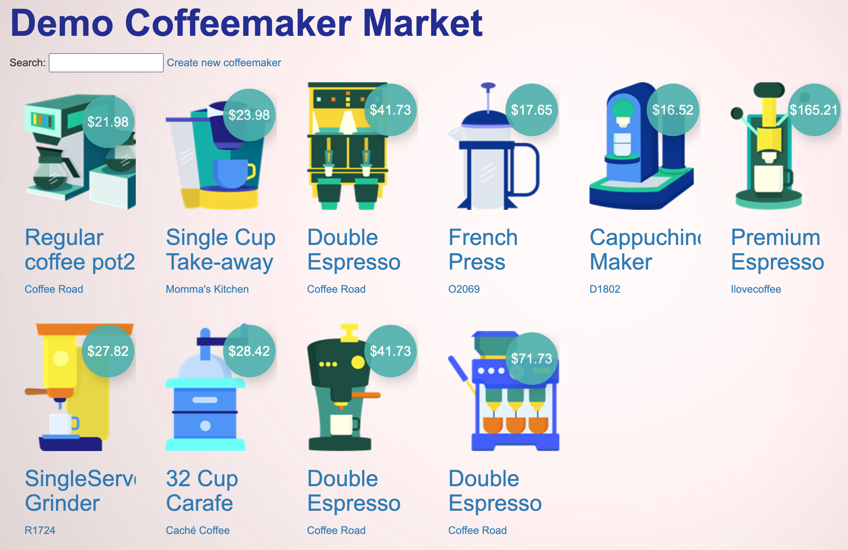
Coffee - It’s The Next Big Thing!
What’s this about?
Use what we learned so far to build a container from a basic IRIS application
Familiarize yourself with working with your container
Push and pull your container from a container registry
Build & Run a multi-container application with docker-compose
Bonus: Learn how to use VS Code & DBeaver with your container

Slide 53
Exercises
Try Exercise 7 – Build Your Own Containerized Application
Then, try the BONUS Exercise
Ask for help if you need it
Next Steps: Containerize your own applications!
Do you feel comfortable doing that now?
If you have questions, please ask!

